Slide 1

Test Driven Development with React - From Padawan To Jedi
Slides up at scottsauber.com
scottsauber

Slide 2

Audience
React Developers
Vaguely familiar with testing
Interested in learning TDD
scottsauber

Slide 3
Agenda
What is TDD?
Why TDD?
What is React?
What do I test?
What tools do I use?
Live Demos
scottsauber

Slide 4

Goals
Learn “best practices*” for writing React tests
Learn how to TDD with React
* Synonym for “Just My Opinions” and I’ll probably find a way I like better in the future
scottsauber

Slide 5


Who am I?
Director of Engineering at Lean TECHniques
Co-organizer of Iowa .NET User Group
Been writing React on/off for 6 years
Friend of Redgate
Blog at scottsauber.com
scottsauber

Slide 6
Why do we write tests?
We want confidence our application works
Minimize manual verification
Document behavior through tests
scottsauber

Slide 7
What is Test Driven Development?
Think
Write a test that describes the behavior you want to see
Run the test and watch it fail for the right reason
Write code to make it pass
Refactor
Repeat
scottsauber

Slide 8
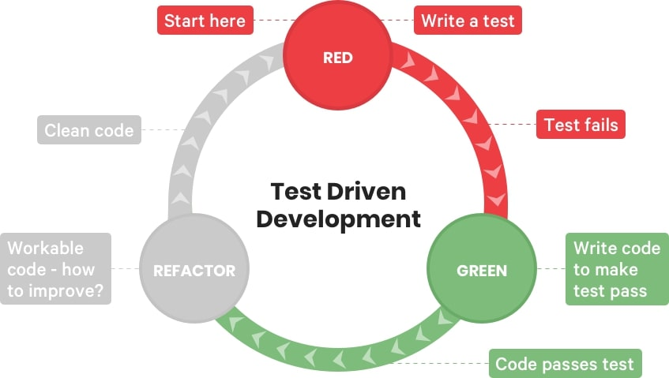
What is Test Driven Development?

Slide 9
Why Test Driven Development?
It’s a disciplined way of working
A great way to focus
A great way to get feedback on if your code and design sucks
A great way to facilitate pair programming
Oh yeah… and the tests are nice too
scottsauber

Slide 10
What is NOT TDD?
A synonym for writing tests
Doing TDD means no bugs ever
Doing TDD means writing ALL the tests up front
scottsauber

Slide 11

Applying TDD to React
Notes:
This is just a hello world create-react-app, so if you run npx create-react-app tdd-demo

Slide 12
Introduction to Tools
Jest
@testing-library/react
scottsauber

Slide 13
Jest
Test framework
Zero config
Assertions
Mocking
Watch
scottsauber

Slide 14
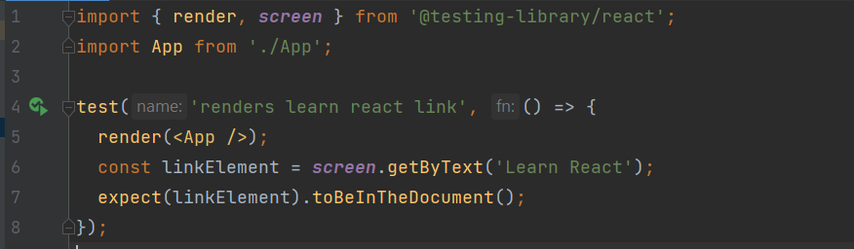
Jest
scottsauber

Slide 15
React Testing Library
@testing-library/react is the package
Utilities for testing React
Encourages behavior-style tests
Avoids testing implementation details
DOM queries that promote accessibility
Promotes deep rendering
Why RTL over Enzyme?
scottsauber

Slide 16
React Testing Library
scottsauber

Slide 17
Demo
Notes:
This is just a hello world create-react-app, so if you run npx create-react-app tdd-demo

Slide 18
What should I test?
Behavior
Not that CSS classes exist
Not that any other attributes directly exist
Behavior
Don’t use snapshots
Snapshots don’t capture desired behavior
Only use snapshots when doing a total refactor but output should be the same
Then delete the test
scottsauber

Slide 19

“The more your tests resemble the way your software is used the more confidence they can give you.”
Kent C Dodds
react-testing-library creator
Notes:
This is just a hello world create-react-app, so if you run npx create-react-app tdd-demo

Slide 20
How do I structure tests?
Avoid lots of describes – never more than 2
Avoid lots of beforeEach nested in describes
Avoid a top-level describe for the component you’re testing
You already know ^ by the file you’re in
Put tests next to the file they’re testing
High cohesion
scottsauber

Slide 21
Live Coding!
Notes:
This is just a hello world create-react-app, so if you run npx create-react-app tdd-demo

Slide 22
How can I get started with TDD?
When you get a bug report coming in
Write a failing test that proves the bug exists
Make it pass
scottsauber

Slide 23

But I don’t have time!

Slide 24

Why?
Notes:
Too understaffed
Too much support work fixing bugs

Slide 25

My boss won’t let me!

Slide 26

What about this person?
Notes:
What if you went to your surgeon and said “Hey I need this operation done” and he goes “Okay it’ll take 24 hours.” And if you respond “Okay but can you do it in 4?” …would you want to get surgery from the surgeon who agrees to that?
“Oh yeah I can totally do that surgery in 4 hours, I just need to not wash my hands, not wash the tools from the last surgery, and I’ll just use 5 stitches to sew you up instead of 50.”

Slide 27
You don’t get better by not doing it

Slide 28

Takeaways
Why you should TDD
How to test React
What to test in React
How to get started TDDing React
scottsauber

Slide 29

Resources
TDD By Example by Kent Beck
Write Tests blog post by Kent C Dodds
github.com/scottsauber/talks
This slide deck
scottsauber

Slide 30
Questions : ssauber@leantechniques.com
Slides up at scottsauber.com
scottsauber

Slide 31
Thanks!
Slides up at scottsauber.com
scottsauber

